Slide 1
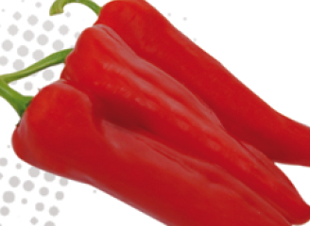
Kaloucha F1 segment Fusetto
HR:PVY: 0, 1, 2 ; IR:CMV
Plant
Open plant with medium vigor.
Under dutch pruning system ramification could be better.
Fruit
Size 150g, 16cm x 5cm
Nice dark red and shiny color.
Fruits have a good ratio between shoulder size and length.
good plants , good yield , early ,darker than Kappy, medium in cracking ( slightly like kappy ), easy to harvest than kappy
Good productivity, Nice dark red fruits with good shoulder length ratio, open plant with medium vigor

Slide 2
Awrar F1 segment Fusetto
HR:PVY: 0, 1, 2 ; IR:CMV
Plant
High yield potential,
might be a bit weak vigour
Fruit
Size 160g, 18cm x 6cm
Nice yellow and shiny color.
high fruit quality, high uniformity
Early setting. First setting could be harvested in green or removed to allow plant to enter colder period with a vigorous plant.

